Slide 1
CS 6476 Project 3
[Chengde Xu]
[cxu368@gatech.edu]
[cxu368]
[903609051]

Slide 2
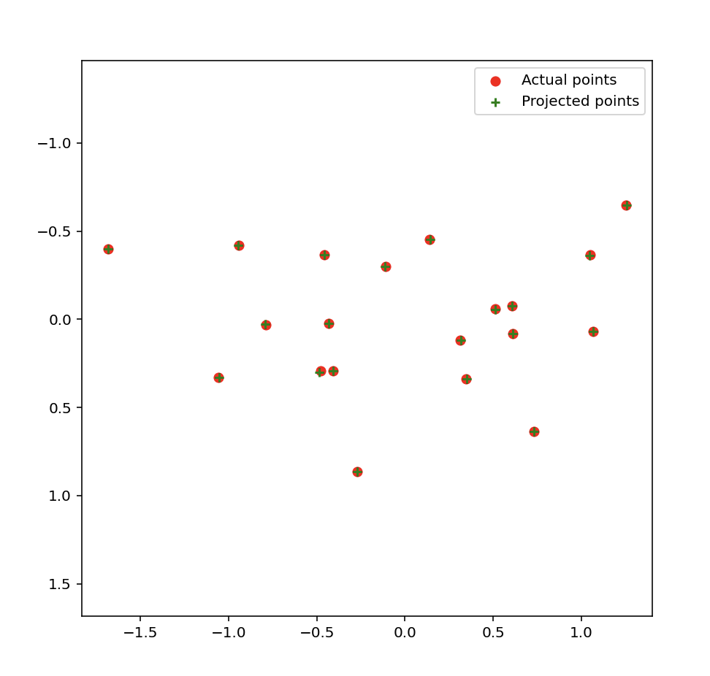
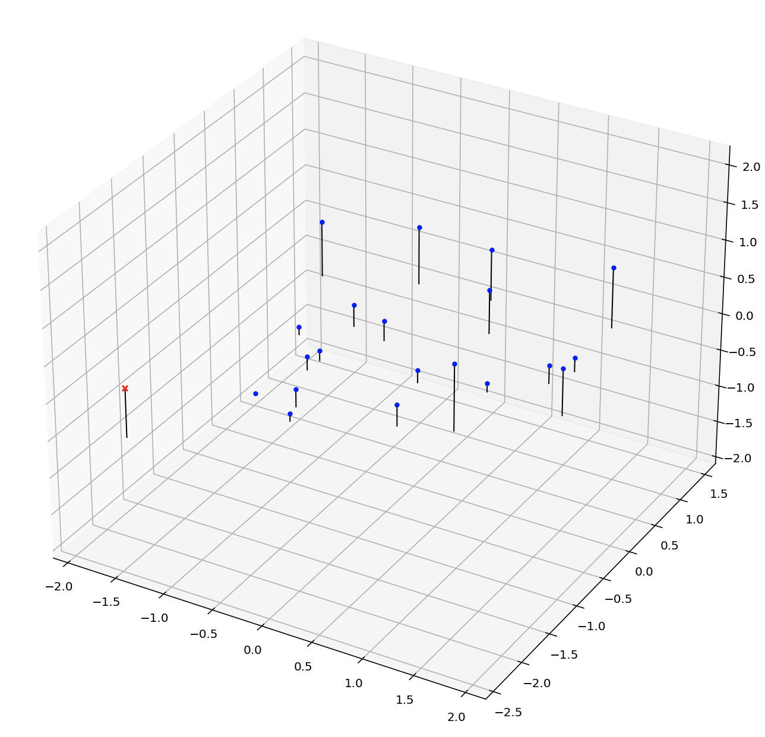
Part 1: Projection matrix
[insert visualization of projected 3D points and actual 2D points for the CCB image we provided here]
[insert visualization of camera center for the CCB image here]

Slide 3
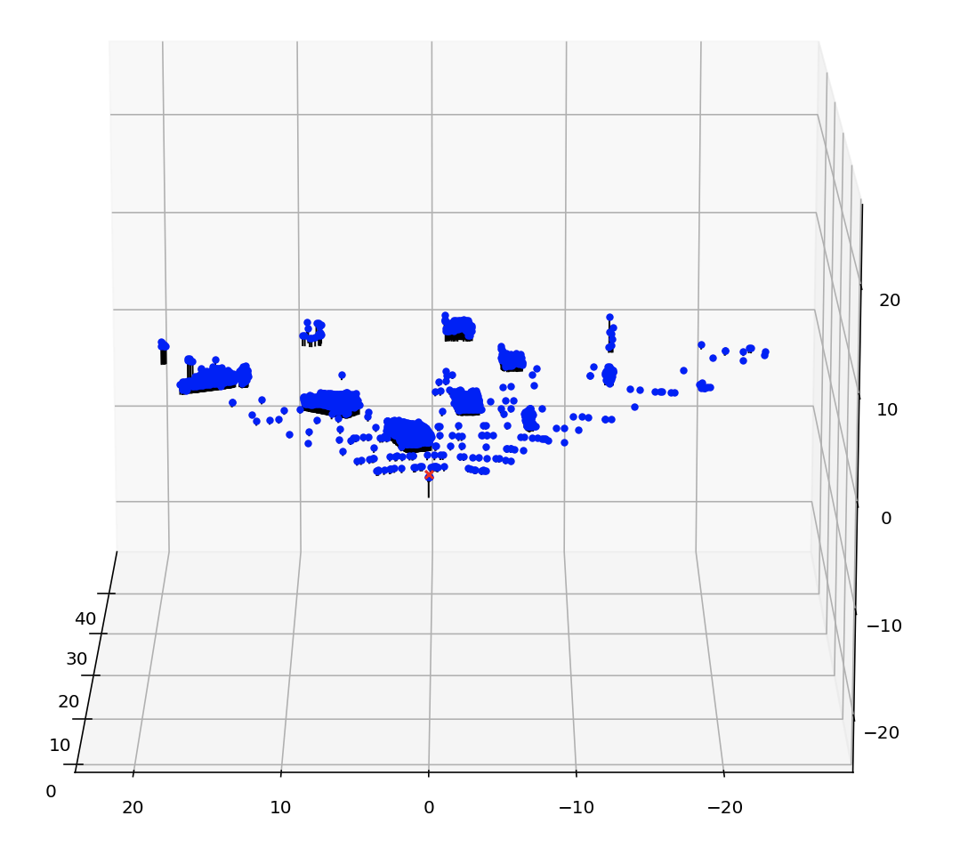
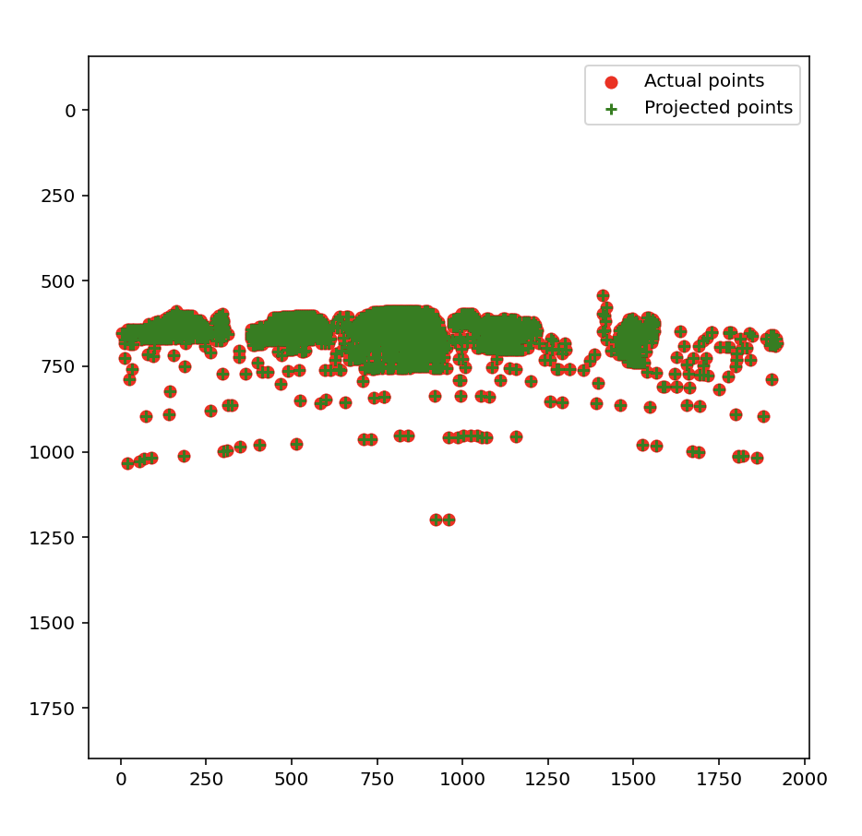
Part 1: Projection matrix
[insert visualization of projected 3D points and actual 2D points for the Argoverse image we provided here]
[insert visualization of camera center for the Argoverse image here]

Slide 4
Part 1: Projection matrix
[What two quantities does the camera matrix relate?]
It relates 3D points to 2D image points.
[What quantities can the camera matrix be decomposed into?]
Intrinsic and extrinsic parameters
[List any 3 factors that affect the camera projection matrix.]
Focal length
Optical center
Rotation and translation of the camera

Slide 5
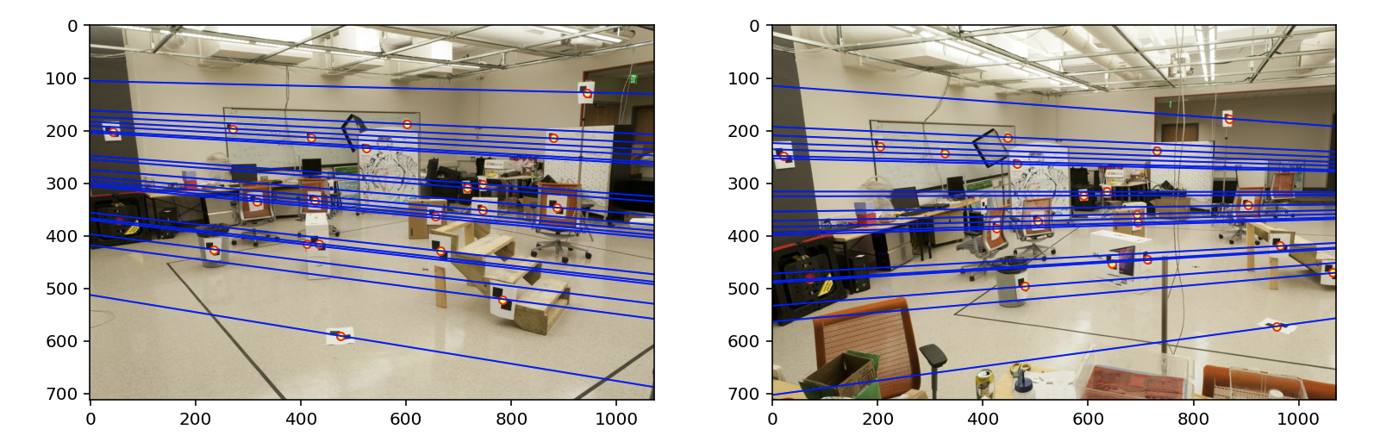
Part 2: Fundamental matrix
[insert visualization of epipolar lines on the CCB image pair]

Slide 6
Part 2: Fundamental matrix
[Why is it that points in one image are projected by the fundamental matrix onto epipolar lines in the other image?]
A point in one image represents a line in 3D space since we don’t know the actual depth of the point. So in the other image, this point is projected onto the epipolar line.
[What happens to the epipoles and epipolar lines when you take two images where the camera centers are within the images? Why?]
All the epipolar lines would converge on the epipole, and the epipole in the image is the optical center of the other camera. Because every epipolar line would cross the projection of the object and the epipole.

Slide 7
Part 2: Fundamental matrix
[What does it mean when your epipolar lines are all horizontal across the two images?]
Image plane of the two cameras are parallel.
[Why is the fundamental matrix defined up to a scale?
Because the translation between two cameras is only up to a scale.
[Why is the fundamental matrix rank 2?]
Because fundamental matrix is constructed from the essential matrix E, and E=[T×]R, [T×] has rank 2.

Slide 8
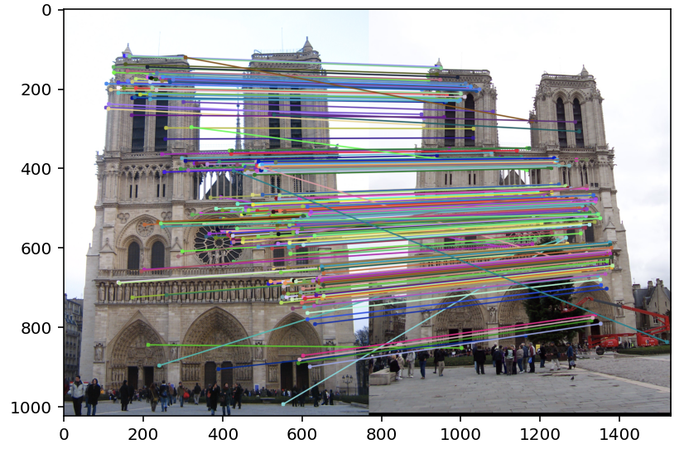
Part 3: RANSAC
[insert visualization of correspondences on Notre Dame after RANSAC]

Slide 9
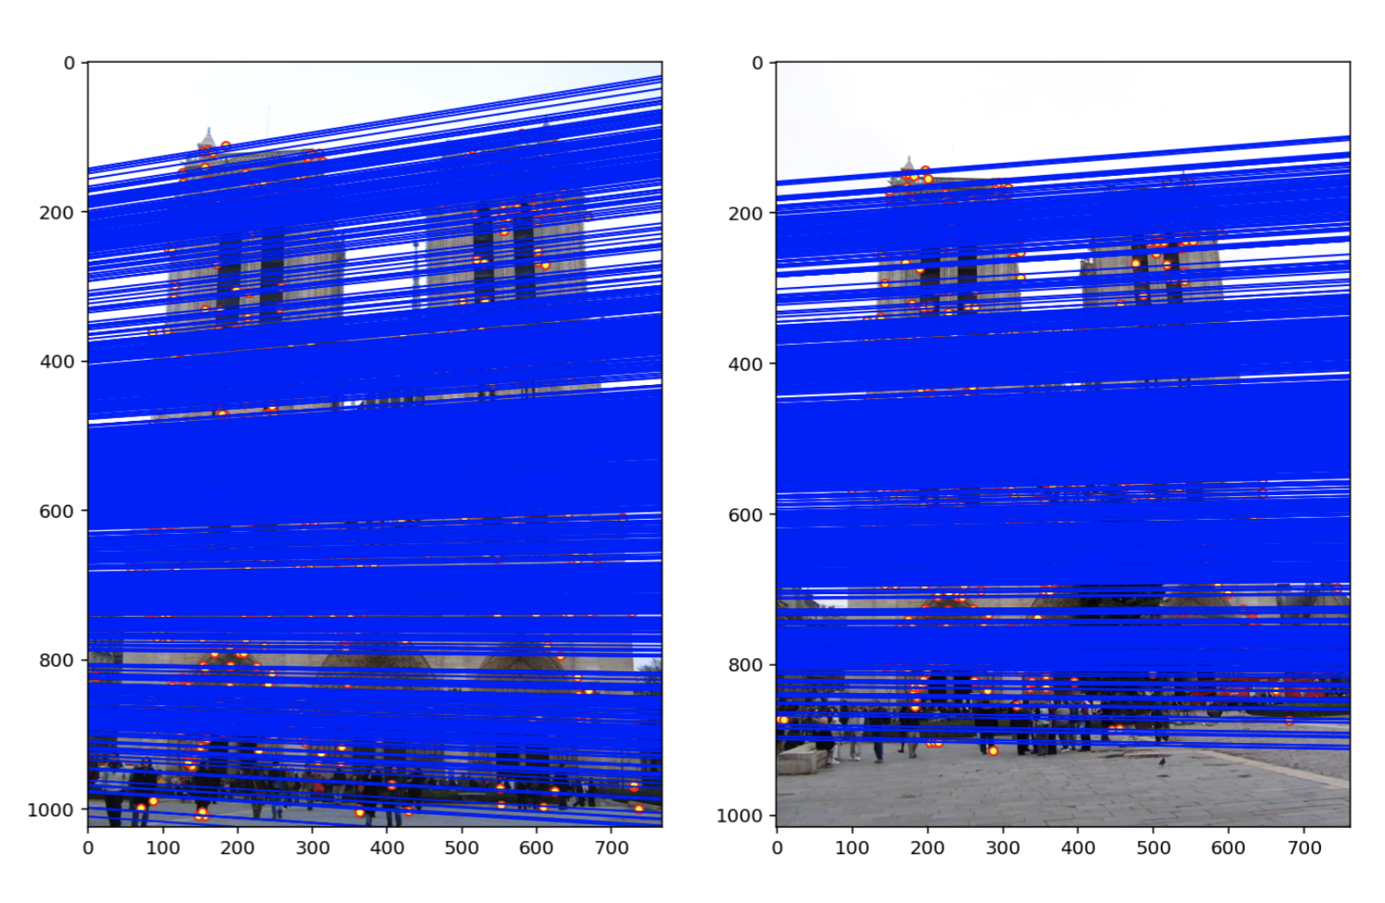
Part 3: RANSAC
[insert visualization of epipolar lines on the Notre Dame image pair]

Slide 10
Part 3: RANSAC
[How many RANSAC iterations would we need to find the fundamental matrix with 99.9% certainty from your Mt. Rushmore and Notre Dame SIFT results assuming that they had a 90% point correspondence accuracy?]
13 iterations
[One might imagine that if we had more than 9 point correspondences, it would be better to use more of them to solve for the fundamental matrix. Investigate this by finding the # of RANSAC iterations you would need to run with 18 points.]
43 iteration would be needed
[If our dataset had a lower point correspondence accuracy, say 70%, what is the minimum # of iterations needed to find the fundamental matrix with 99.9% certainty?]
117 iterations

Slide 11
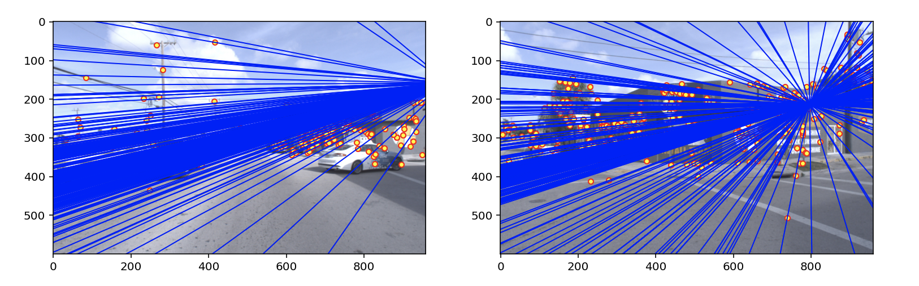
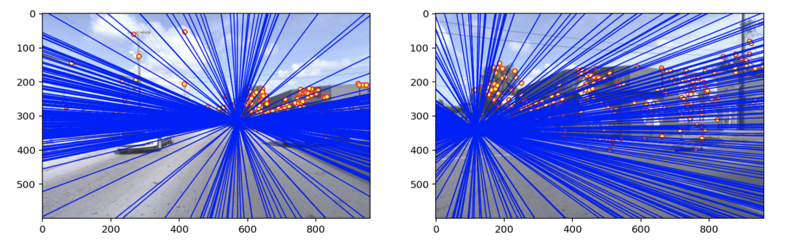
Part 4: Performance comparison
[insert visualization of epipolar lines on the Argoverse image pair using the linear method]
[insert visualization of epipolar lines on the Argoverse image pair using RANSAC]

Slide 12
Part 4: Performance comparison
[Describe the different performance of the two methods.]
Without RANSAC, the epipole falls out the the left image, and the positions of the epipole differ between two pair of images.
[Why do these differences appear?]
Without RANSAC, the fundamental matrix try to fit all the matching point, so the position of the epipole is highly influenced by the outliers (mismatched points).
[Which one should be more robust in real applications? Why?]
With RANSAC estimation would be more robust, because in real application, mismatched points would be very common. If those points influence the position of the epipole, we would get the wrong position.

Slide 13
Part 5: Visual odometry
[How can we use our code from part 2 and part 3 to determine the “ego-motion” of a camera attached to a robot (i.e., motion of the robot)?]
With code from part 2 and part 3, we can calculate the relative position of the camera center to certain objects. Between two frames, suppose we keep the objects still, we can get two different position of camera center, which represents the motion of the camera.
[In addition to the fundamental matrix, what additional camera information is required to recover the ego-motion?]
The intrinsic parameters is required.

Slide 14
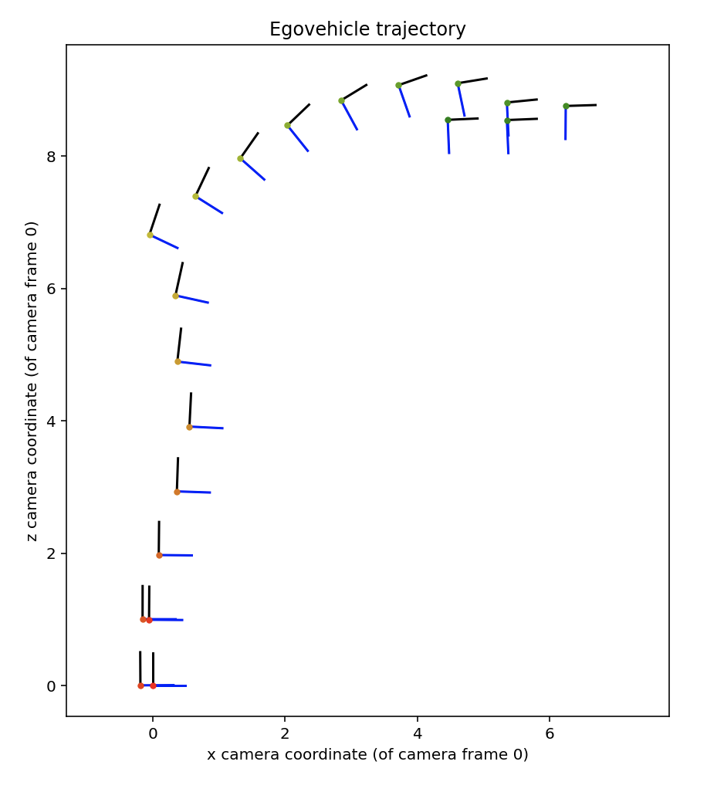
Part 5: Visual odometry
[Attach a plot of the camera’s trajectory through time]

